Slide 1
Machine Learning
Final project
第一原理AI化-最佳SAA催化劑吸附能預測
Teammates: | 高睿成 陳冠儒 蔡沂華
Teachers: | 陳南佑 老師 楊安正 老師

Slide 2
Outline
Introduction
Training set
Model
Results & discussion
Job arrangement

Slide 3
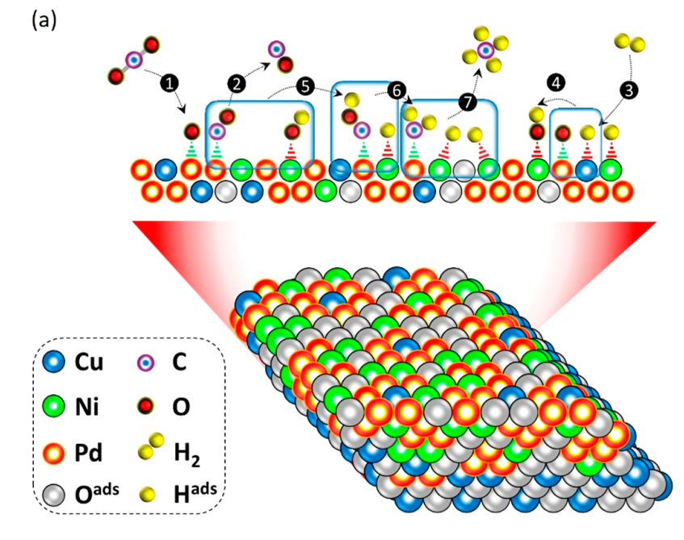
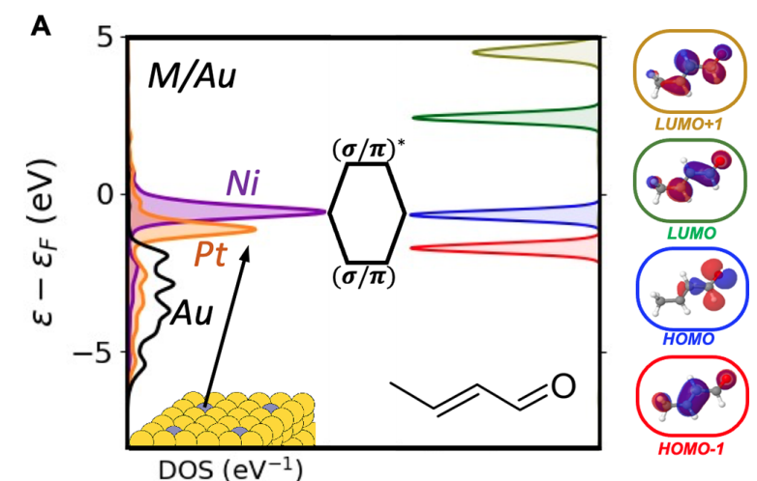
Introduction
Surface catalysis reaction highly depends on the adsorption energy.
The density of states (DOS) of the catalysts and adsorbates contribute the adsorption energy (E_{ads}).
Using machine learning to predict the adsorption energy of the reactants and intermediates through DOS plots.
CO₂RR
E_{ads}
ACS Appl. Energy Mater. 2021, 4, 14043−14058
J. Am. Chem. Soc. 2021, 143, 11897−11902
3

Slide 4
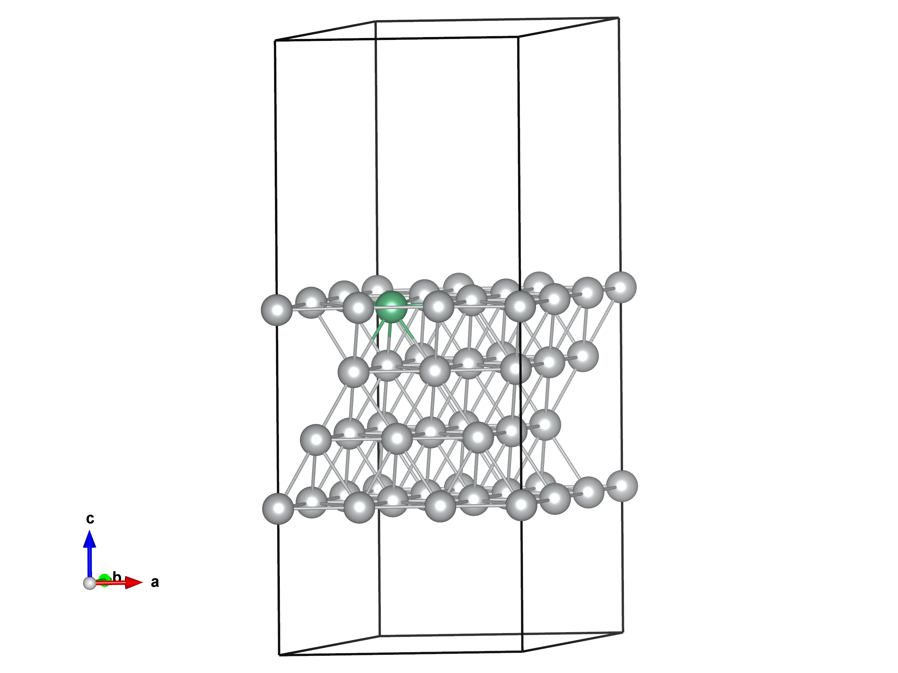
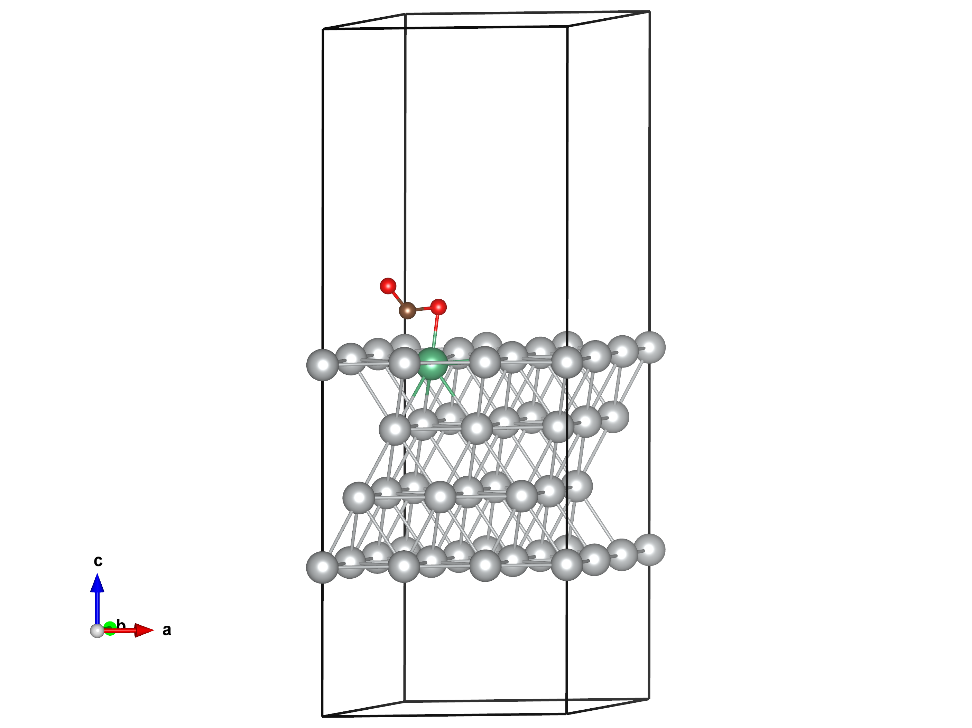
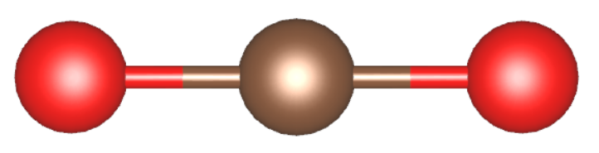
Introduction
Single atom alloy (SAA)
Bimetallic systems (dilute solution)
Weak mixing between constituent metal wave functions
Sharp and narrow d-band
Ag₃₅Nb₁
Strong E_{ads}
The interaction between d-band and adsorbate level
Gas adsorption
CO₂ adsorption on Ag₃₅Nb₁
4

Slide 5
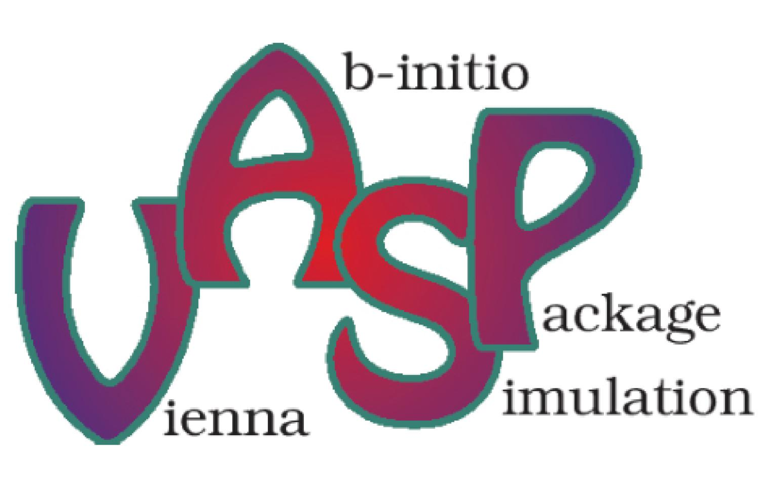
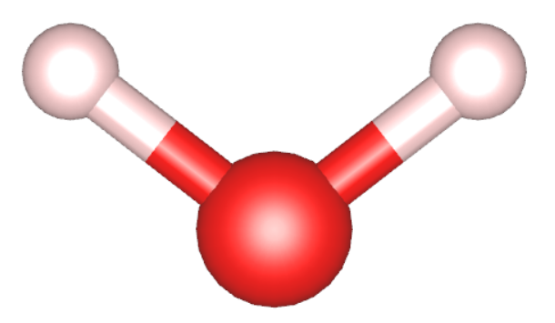
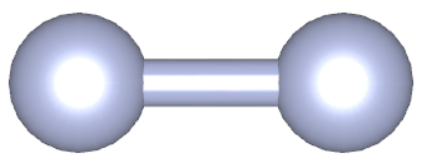
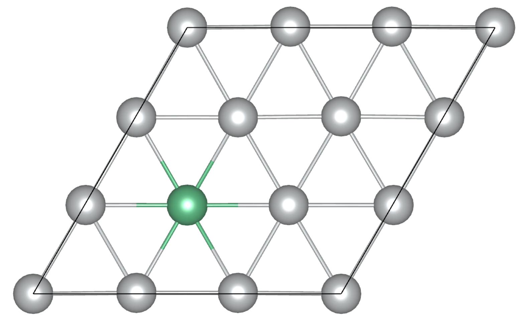
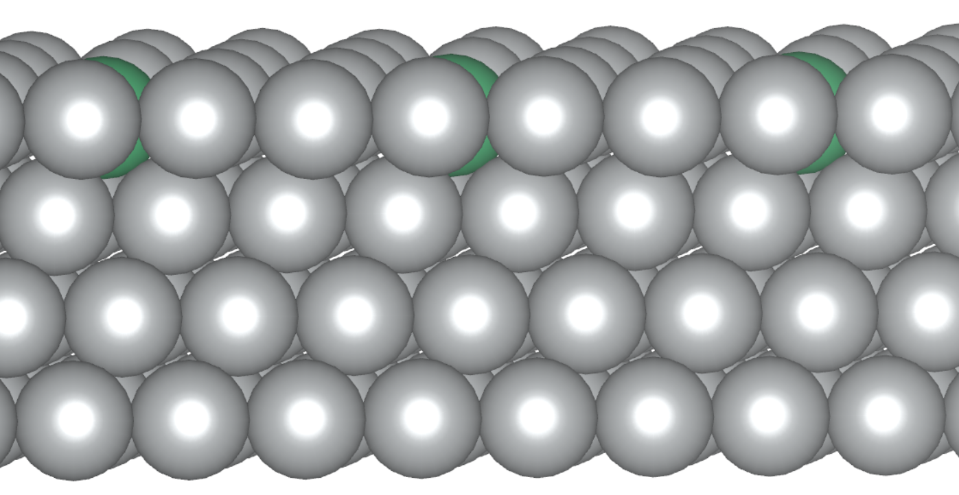
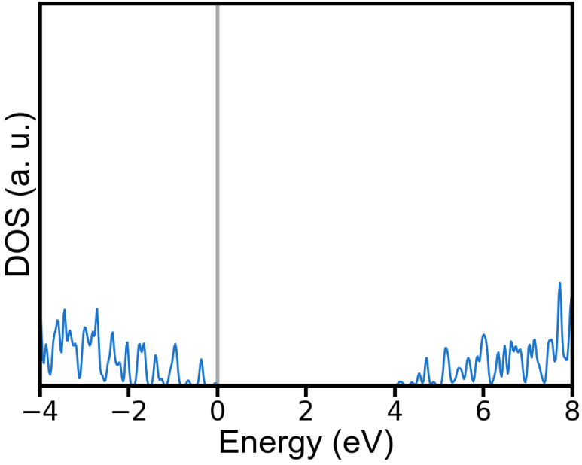
Training set
Density functional theory (DFT) calculation
4 atomic layers fcc (111) surface model
3 host elements + 20 guest elements + 16 adsorbates
960 combinations
TDOS + PDOS for the top 9 atoms on the surface and adsorbates with s, p, d channels
41 features
Input data (DOS)
Output data (E_{ads})

Slide 6
Data Generation
Host elements: Au, Ag, Cu
Guest elements:
Ti | V | Cr | Mn | Fe
Co | Ni | Zr | Nb | Mo
Ru | Rh | Pd | Hf | Ta
W | Re | Os | Ir | Pt
Adsorbates:
H | H₂ | OH | H₂O | O
O₂ | OOH | C | CO₂ | CO
CH₃ | COH | CHO | N | N₂
NH₃
J. Am. Chem. Soc. 2021, 143, 11897−11902
J. Mater. Chem. A, 2019, 7, 3531–3543
Chem. Sci., 2019, 10, 9165–9181
Energy Sci. Eng., 2021, 9, 1012–1032
ACS Catal., 2020, 10, 1754−1768
J. Phys. Energy, 2021, 3, 026001
Totally 960 combinations

Slide 7
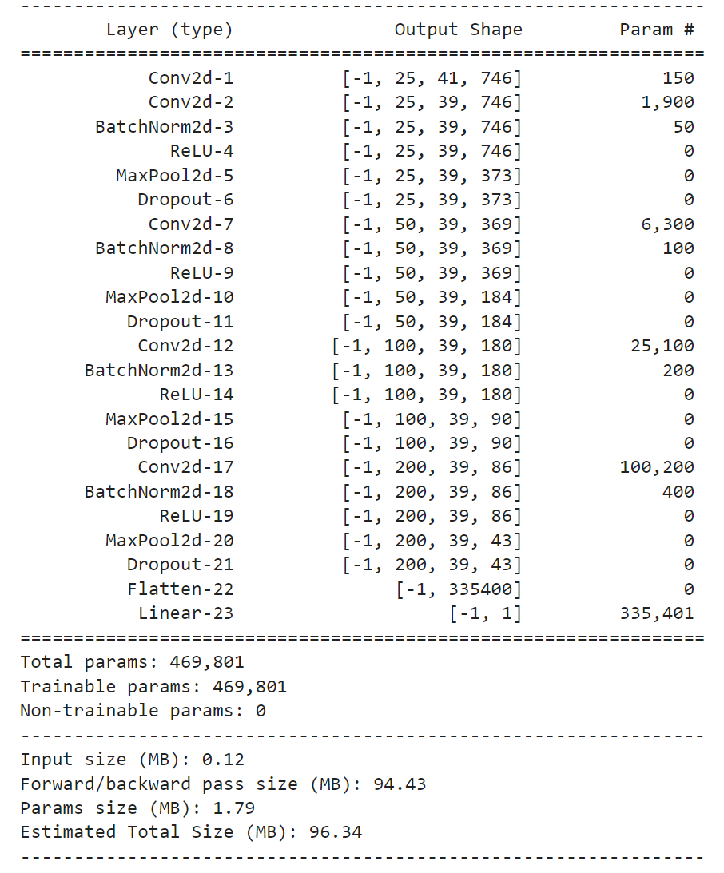
Model
Model 1: DeepConvNet
Model 2: EEGNet

Slide 8
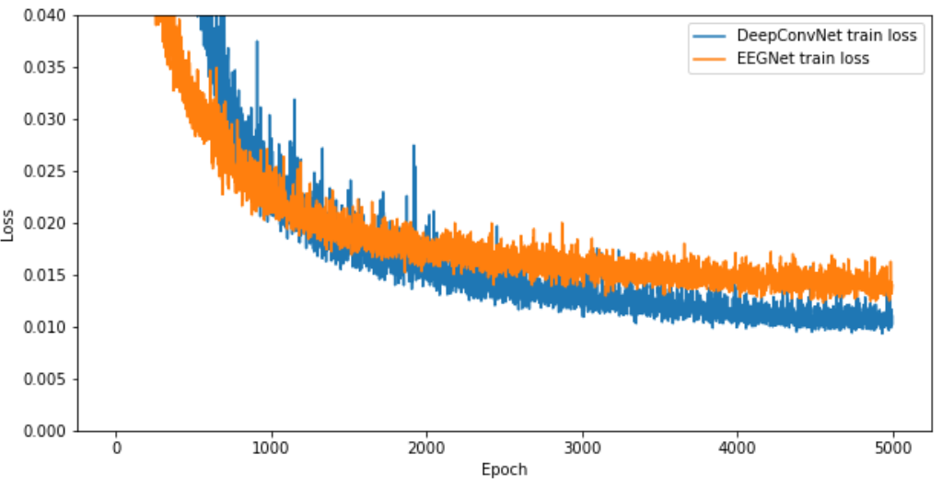
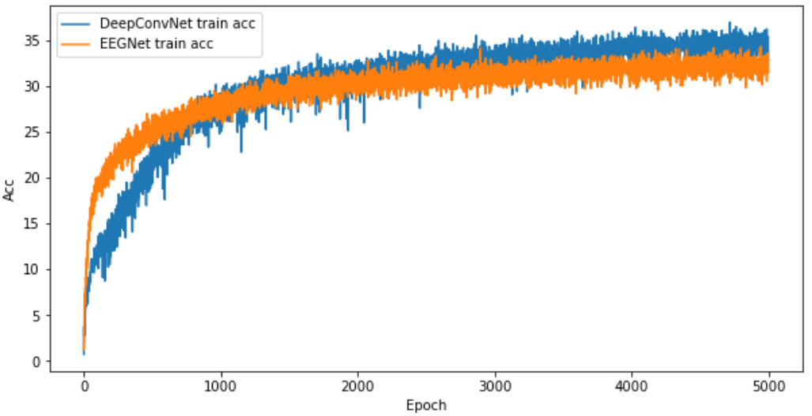
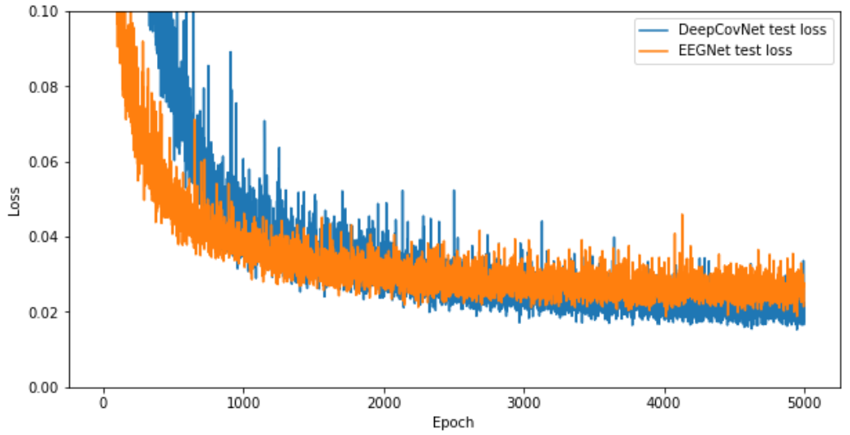
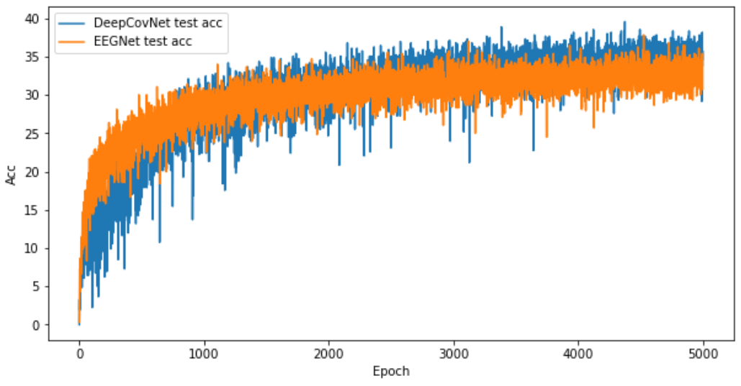
Results & discussion
Loss
Accuracy (%)
Epoch
Epoch
Loss
Accuracy (%)
Epoch
Epoch

Slide 9
Results & discussion
比較不同model results
比較不同training set (反應前DOS vs 反應後DOS)

Slide 10
Results & discussion
分Ag, Au, Cu三類
分guest elements二十類
分full & single 二群

Slide 11
Job arrangement
高睿成: 主導final project/data generation/ppt製作/ppt講解/書面報告製作
陳冠儒: main code/ppt製作/ppt講解
蔡沂華: data post-process/ppt製作/ppt講解/書面報告製作

